Slide 1

Beware Bitterness!

Slide 2
What does the peaceable fruit
of righteousness look like?

Slide 3

BY FAITH
YOU ARE FOR OTHERS THAT NEED YOU.
God chastises His own.
You learn that yes, God cares for you, but that it’s not all about you.

Slide 4
Isaiah 35:3-4 Strengthen ye the weak hands, and confirm the feeble knees. 4 Say to them that are of a fearful heart, Be strong, fear not: behold, your God will come with vengeance, even God with a recompence; he will come and save you.

Slide 5
Job 4:3-4 Behold, thou hast instructed many, and thou hast strengthened the weak hands. 4 Thy words have upholden him that was falling, and thou hast strengthened the feeble knees.
1 Thess 5:14 Now we exhort you, brethren, warn them that are unruly, comfort the feebleminded, support the weak, be patient toward all men.

Slide 6
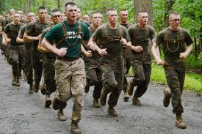
BY FAITH
YOU LIVE RIGHT IN THE CIRCUMSTANCES OF YOUR LIFE FOR OTHERS THAT NEED YOU!
When you live for Christ…
It encourages others to do the same.

Slide 7
Prov 4:26-27 Ponder the path of thy feet, and let all thy ways be established. 27 Turn not to the right hand nor to the left: remove thy foot from evil.

Slide 8
Gal 6:1-3 Brethren, if a man be overtaken in a fault, ye which are spiritual, restore such an one in the spirit of meekness; considering thyself, lest thou also be tempted. 2 Bear ye one another's burdens, and so fulfil the law of Christ. 3 For if a man think himself to be something, when he is nothing, he deceiveth himself.

Slide 9
Jude 1:20-25 But ye, beloved, building up yourselves on your most holy faith, praying in the Holy Ghost, 21 Keep yourselves in the love of God, looking for the mercy of our Lord Jesus Christ unto eternal life. 22 And of some have compassion, making a difference: 23 And others save with fear, pulling them out of the fire; hating even the garment spotted by the flesh. 24 Now unto him that is able to keep you from falling, and to present you faultless before the presence of his glory with exceeding joy, 25 To the only wise God our Saviour, be glory and majesty, dominion and power, both now and ever. Amen.

Slide 10
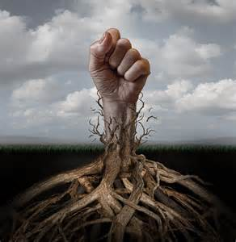
BY FAITH
A WARNING TO DILIGENCE TOWARD BITTERNESS.
Notice bitterness is a “root” – it’s hidden.
Bitterness is a great sin.

Slide 11
2 Cor 4:8-18 We are troubled on every side, yet not distressed; we are perplexed, but not in despair; 9 Persecuted, but not forsaken; cast down, but not destroyed; 10 Always bearing about in the body the dying of the Lord Jesus, that the life also of Jesus might be made manifest in our body. 11 For we which live are alway delivered unto death for Jesus' sake, that the life also of Jesus might be made manifest in our mortal flesh. 12 So then death worketh in us, but life in you. 13 We having the same spirit of faith, according as it is written, I believed, and therefore have I spoken; we also believe, and therefore speak;

Slide 12
14 Knowing that he which raised up the Lord Jesus shall raise up us also by Jesus, and shall present us with you. 15 For all things are for your sakes, that the abundant grace might through the thanksgiving of many redound to the glory of God. 16 For which cause we faint not; but though our outward man perish, yet the inward man is renewed day by day. 17 For our light affliction, which is but for a moment, worketh for us a far more exceeding and eternal weight of glory; 18 While we look not at the things which are seen, but at the things which are not seen: for the things which are seen are temporal; but the things which are not seen are eternal.

Slide 13
2 Cor 12:9-10 And he said unto me, My grace is sufficient for thee: for my strength is made perfect in weakness. Most gladly therefore will I rather glory in my infirmities, that the power of Christ may rest upon me. 10 Therefore I take pleasure in infirmities, in reproaches, in necessities, in persecutions, in distresses for Christ's sake: for when I am weak, then am I strong.

Slide 14
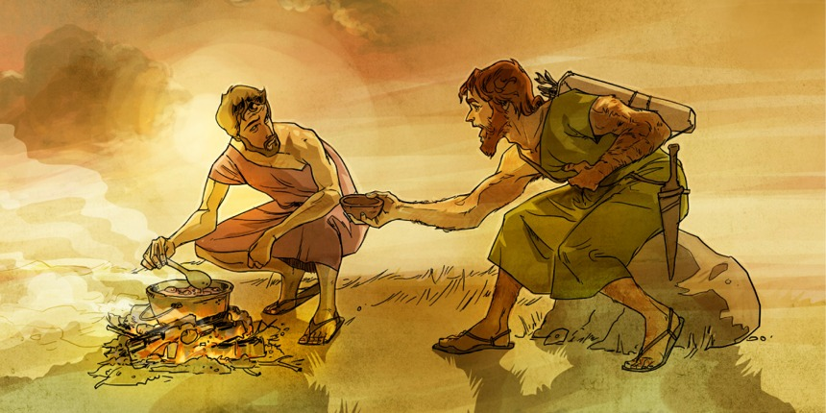

Slide 15
Rom 9:10-13 And not only this; but when Rebecca also had conceived by one, even by our father Isaac; 11 (For the children being not yet born, neither having done any good or evil, that the purpose of God according to election might stand, not of works, but of him that calleth;) 12 It was said unto her, The elder shall serve the younger. 13 As it is written, Jacob have I loved, but Esau have I hated.

Slide 17
Gen 27:38-41 And Esau said unto his father, Hast thou but one blessing, my father? bless me, even me also, O my father. And Esau lifted up his voice, and wept. 39 And Isaac his father answered and said unto him, Behold, thy dwelling shall be the fatness of the earth, and of the dew of heaven from above; 40 And by thy sword shalt thou live, and shalt serve thy brother; and it shall come to pass when thou shalt have the dominion, that thou shalt break his yoke from off thy neck. 41 And Esau hated Jacob because of the blessing wherewith his father blessed him: and Esau said in his heart, The days of mourning for my father are at hand; then will I slay my brother Jacob.

Slide 18
Bitterness comes when you will
not submit to God’s providence.

